Slide 1

Note: The data and information in this document is reflective of a hypothetical situation and client. This document is to be used for KPMG Virtual Internship purposes only.
Sprocket Central Pty Ltd
Data analytics approach
Virtual Intern - Kocharyan Samvel
https://www.linkedin.com/in/samvelkoch/

Slide 2
Note: The data and information in this document is reflective of a hypothetical situation and client. This document is to be used for KPMG Virtual Internship purposes only.
Agenda
Introduction
Data Exploration
Model Development
Interpretation

Slide 3
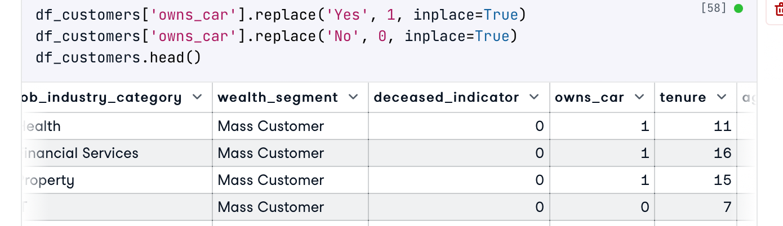
Note: The data and information in this document is reflective of a hypothetical situation and client. This document is to be used for KPMG Virtual Internship purposes only.
Introduction
Data Points towards to Customer Success
31 useful data points to Explore and create features for:
Demographic Analysis
Customer Segmentation
Purchase behavior
RFM (recency, frequency, monetary)
RPR (Repeat Purchase Rate)
CRR (Customer Retention Rate)

Slide 4
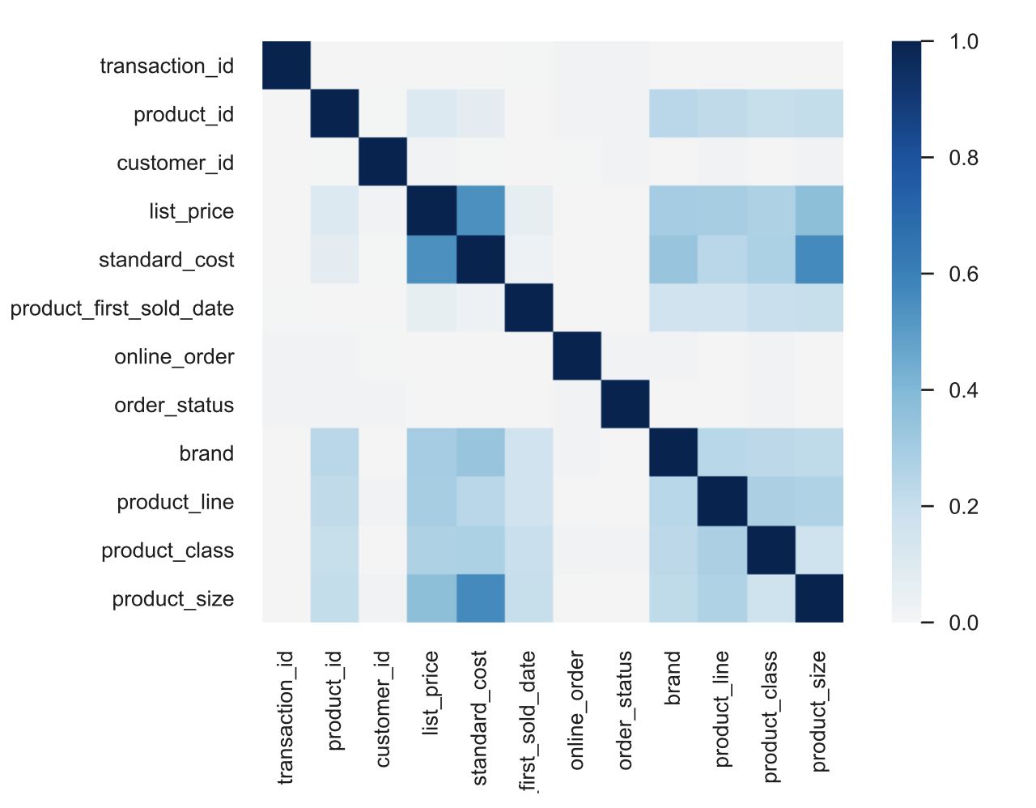
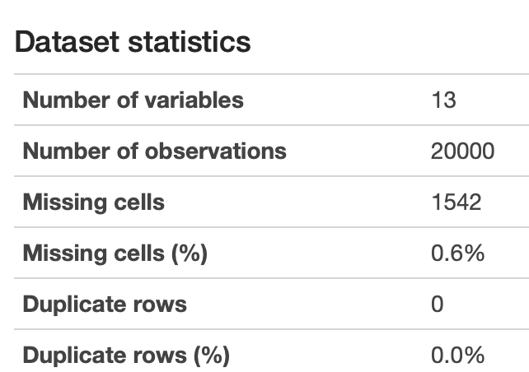
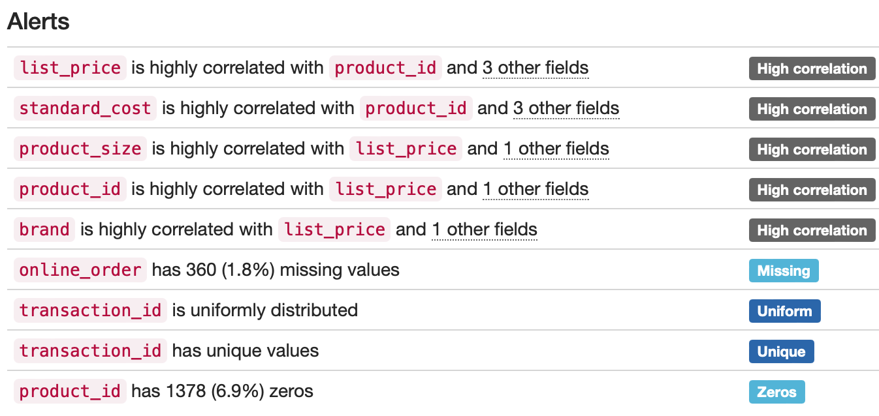
Note: The data and information in this document is reflective of a hypothetical situation and client. This document is to be used for KPMG Virtual Internship purposes only.
Data Exploration
1. From Questions to ANSWERS
2. From Answers to INSIGHTS
3. From Insights to ACTION
4 000 customers
20 000 orders
correlation does not imply causation…
WE know what to ASK and how use to your Data INSIGHTS

Slide 5
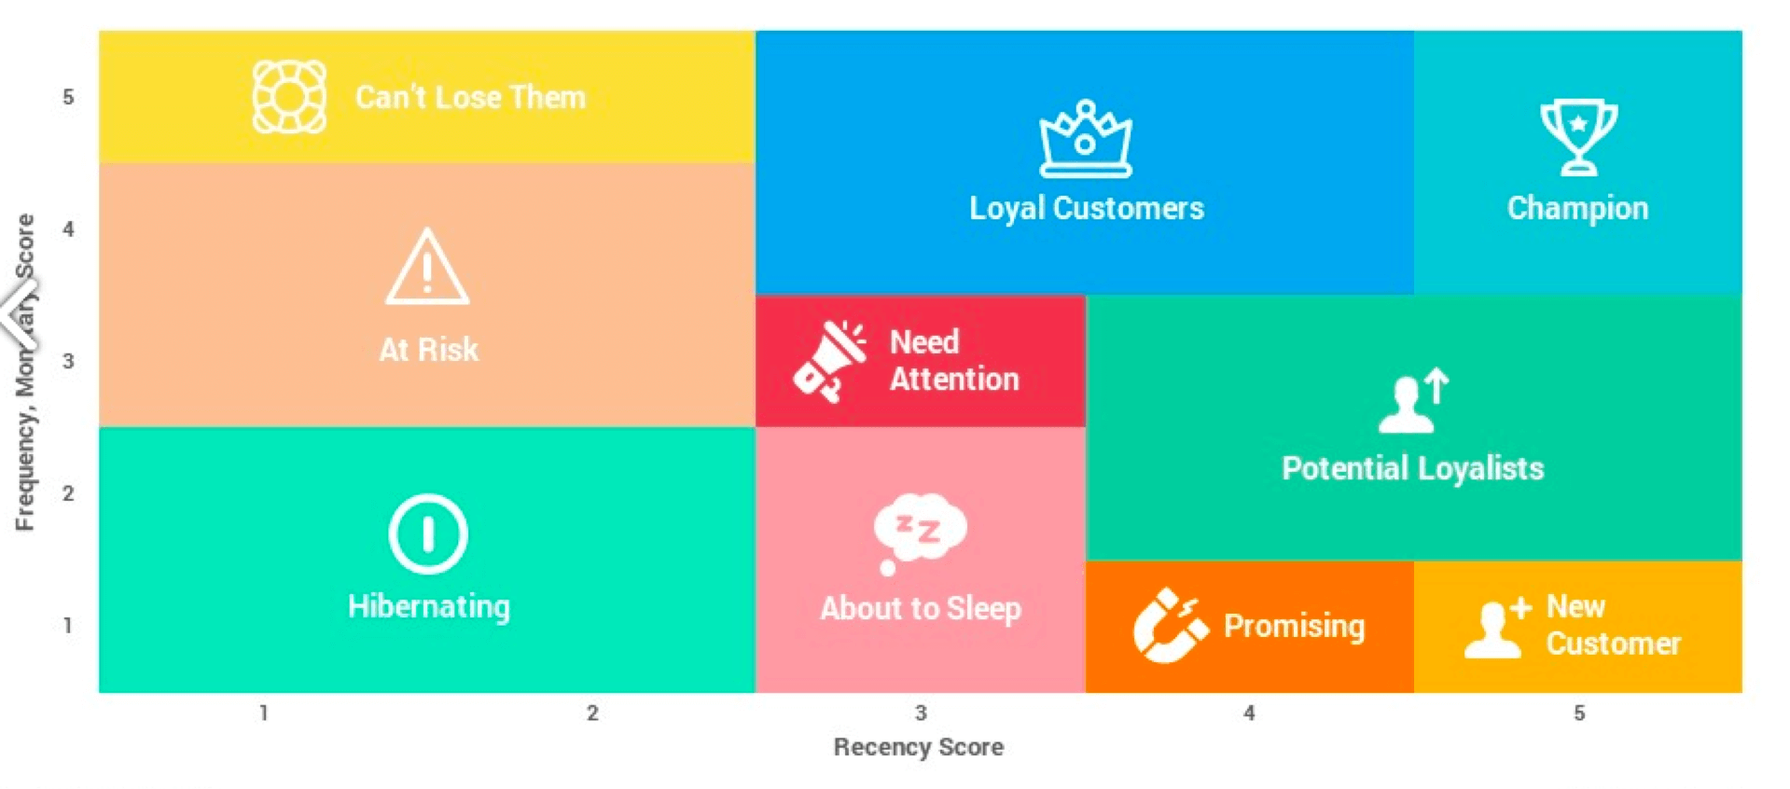
Note: The data and information in this document is reflective of a hypothetical situation and client. This document is to be used for KPMG Virtual Internship purposes only.
Model Development
Right strategy to approach the Data Model
Demographic analysis: gender, age group, demographic categories.
Purchase behavior analysis: to understand the customer's purchasing habits and preferences.
Customer segmentation: to understand your customer
Geographical analysis: to identify any regional patterns in their purchasing behavior.
Product analysis: to identify any trends in product purchasing
Retention analysis: to identify any factors that may affect customer retention.
RFM (Recency / Frequency / Monetary) - to identify the best customers and perform targeted marketing campaigns.

Slide 6
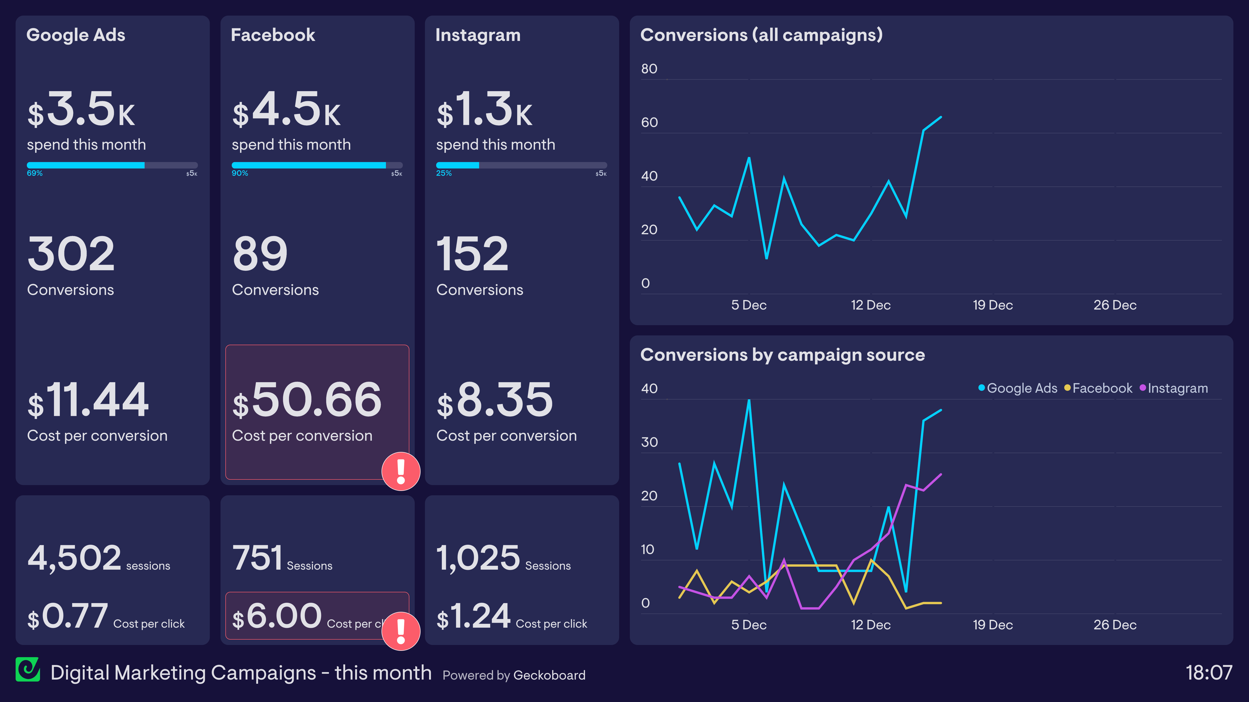
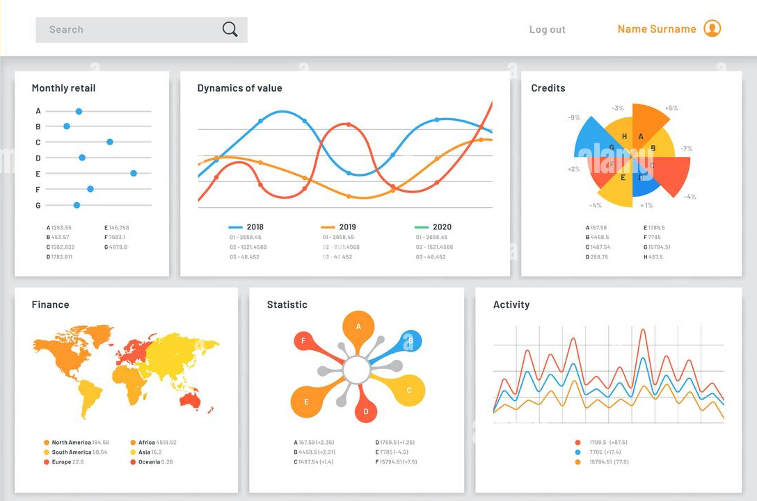
Note: The data and information in this document is reflective of a hypothetical situation and client. This document is to be used for KPMG Virtual Internship purposes only.
Interpretation
The Story of your Data
The Set of Dashboards
KPMG consulting SME sessions to support Action plan
Detailed Insights
Reproducible analysis for future

Slide 7
Note: The data and information in this document is reflective of a hypothetical situation and client. This document is to be used for KPMG Virtual Internship purposes only.
Appendix

Slide 8
Note: The data and information in this document is reflective of a hypothetical situation and client. This document is to be used for KPMG Virtual Internship purposes only.
Appendix
Additional Materials
Data Exploration Toolset:
Pyhton, Pandas, Excel, Profiling
Data Visualizations toolset:
Matplotlib, Seaborn, Tableau
Additional Files: Data quality reports, Python analysis notebook
Vizualisations

